Slide 1
Asp.Net
Ch. 01
Validation Controls in ASP.Net

Slide 2
Introduction to Validation controls:
Validation controls are most important and useful feature introduced by ASP.Net
Validation controls are used to control and validate the given data.
Validating a form is most important part of Website development.
To check that given data is in specific format or not we can use validation controls.
Using validation controls data validation could be done in couple of minutes.
Validation controls will not use long coding for validating data.

Slide 3
Introduction to Validation controls:
Form validation can be done in two ways :
  Client Side Validation
  Server Side Validation
Client Side Validation :
  Client Side validation means that checking of data format or validation is done at Client Side.
  Client side validation is done by browser itself.
  If all the action of user goes to server side, then the processing would be done on server side and then revert back the response.

Slide 4
Introduction to Validation controls:
  To send request each time and got response each time then it would take too much time to get the page processed.
  To avoid long time processing we can used client side validation.
  The client side validation gives faster response to Client.
  The client side validation is written in a script section.
  In ASP.NET several controls are available to carry out Client Side Validation.

Slide 5
Introduction to Validation controls:
Server Side Validation :
  Server side validation means the checking of data format or validation is carried out at Server Side.
  This is more safe then client side validation.
  ASP.NET provides some powerful controls to maintain Server Side Validations.

Slide 6
Validation Controls :
The Controls that are used to validate the data against some input format are known as Validation Controls.
If the data does not pass the validation, it will display an error message to the user and user would not be able to submit the data.
There are 6 (six) validation controls :
  RequiredFieldValidator
  CompareValidator
  RangeValidator
  RegularExpression Validator
  CustomValidator
  ValidationSummary

Slide 7
Validation Controls :
All the validation controls are derived from BaseValidator Class.
Properties of BaseValidator class can be as :
Properties | Meaning
ControlToValidate | This property is used to set the control which we want to validate. Like, textbox, listbox, dropdownlist and many other.
ErrorMessage | This property is used to set error message which will be displayed when validator control fails.

Slide 8
Validation Controls :
Properties | Meaning
IsValid | It returns either TRUE or FALSE after checking the validation control. If any of the validation fails, then IsValid property returns false.
Enabled | It is used to enable or disable automatic checking of validation control.
Text | Used to set error message, which would only be displayed on validator control.
CausesValidation property of Button | We can enable and disable validation check on button click

Slide 9
Required Field Validator :
RequiredFieldValidator Control :
  Required Field Validator control is used when we want some value must be entered for the particular control with a proper validation.
  It makes us to enter a value into a form control before submitting the form.
  If we do not enter a value in the form, it gives error.
  As an Example of using RequiredFieldValidator is username for login must not blank.

Slide 10
Required Field Validator :
Syntax of RequireFieldValidator:
  <asp:RequiredFieldValidator
    ID=“RequiredFieldValidator1”
    runat=“server”
    ControlToValidate=“TextBox1”
    ErrorMessage=“UserName Must not blank”>
  </asp:RequiredFieldValidator>

Slide 11
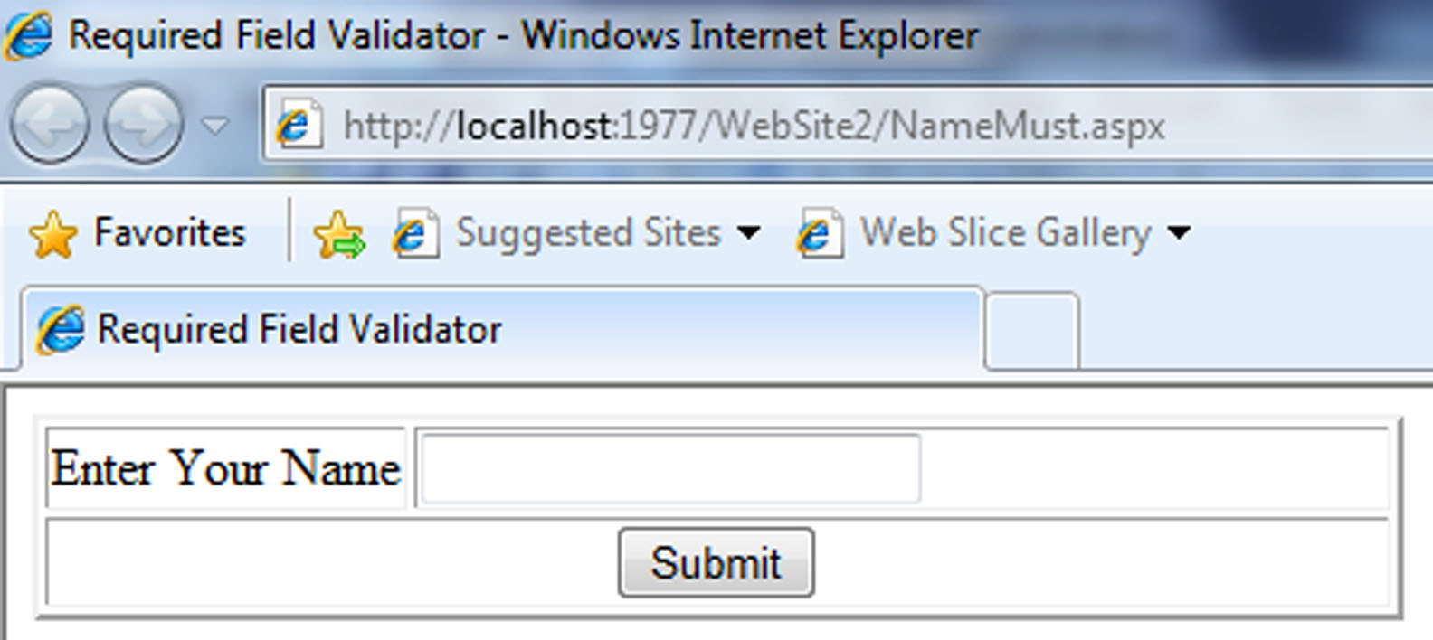
Def. Design a form to enter your name and submit. (Name must entered in text box or display ERROR).

Slide 12
Required Field Validator : GUI
We can also set RequiredFieldValidator using GUI (Graphical User Interface) too.
Add a text control in your design view.
Now drag and drop a new RequiredFieldValidator control on the form. (Put it at a position where you want to display output for required field validator).
Now set the properties for RequiredFieldValidator as given
  ControlToValidate=<Name of Control>
  ErrorMessage=<Message Of Error>

Slide 13
Different types of Validation Controls :
CompareValidator Control :
  CompareValidator control is used to check value of two controls.
  It is used to check whether both controls have got same value or not.
  If not then it gives an error message else nothing.
  Example of CompareValidator is Password and Confirm Password.
  In this example we compare whether both the passwords entered are same or not.

Slide 14
Different types of Validation Controls :
  CompareValidator not only compare two controls, but it also checks the data type of the control.
  For example if we want that control have only integer value or string value, it is possible using this control.
  Some example of CompareValidator are:
    Confirm email address must be same
    Confirm password must be same

Slide 15
Different types of Validation Controls :
Properties of CompareValidator can be as :
Properties | Meaning
ControlToCompare | This property is used to set the control which you want to compare with given control. Values of ControlToValidate and ControlToCompare must be same.
ValueToCompare | This property is used to set specific value to be compared with this control.

Slide 16
Different types of Validation Controls :
Properties of CompareValidator can be as :
Properties | Meaning
ControlToValidate | This property is used to set the control which you want to validate with given control. Values of ControlToValidate and ControlToCompare must be same.
ValueToCompare | This property is used to set specific value to be compared with this control.

Slide 17
Different types of Validation Controls :
Properties | Meaning
Type | It is used to specify the type of value which you are comparing with the control. It checks that both the controls which are compare should have same type. Type can be String, Date, Currency or Integer.
Operator | The type of comparison which would be performed. Some of the operators are: Equal, GreaterThan, GreaterThan Equal, LessThan, LessThan Equal, NotEqual.

Slide 18
Compare Validator :
Syntax of CompareValidator: Two Controls
  <asp:CompareValidator
    ID=“CompareValidator1”
    runat=“server”
    ControlToCompare=“TextBox1”
    ControlToValidate=“TextBox2”
    Operator=“Equal”
    ErrorMessage=“Password Must be Same”>
  </asp:CompareValidator>

Slide 19
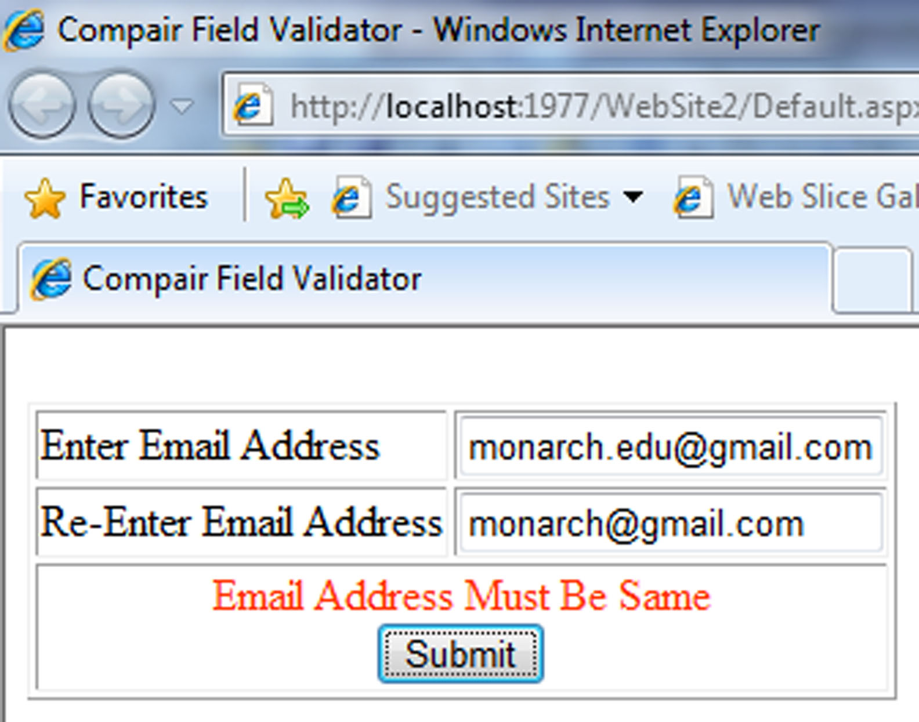
Def. Design a form to enter your Email address two times and submit. (Both address must be same or display ERROR).

Slide 20
Different types of Validation Controls :
RangeValidator Control :
  RangeValidator control is used to check value of the control falls between specific range or not.
  The value can be of type numeric, date or string.
Some example of RangeValidator Control are:
  1. Input age within a specific range.
  2. Input Birth date within a range.

Slide 21
Different types of Validation Controls :
Properties of RangeValidator can be as :
Properties | Meaning
MinimumValue | This property is used to set the Minimum value that this controls can process.
MinimumValue | This property is used to set the Minimum value that this controls can process.
Type | It is used to specify the type of value which you are comparing with the control. It checks that both the controls which are compared should have same datatype. Type can be String, Double, Date, Currency or Integer.

Slide 22
RangeValidator :
Syntax of RangeValidator:
  <asp:RangeValidator
    ID=“RangeValidator1” runat=“server”
    ControlToCompare=“TextBox1”
    ErrorMessage=“Age Between 18 to 22”
    Type=“Integer”
    MinimumValue=“18”
    MaximumValue=“22” >
  </asp:RangeValidator>

Slide 23
Different types of Validation Controls :
RegularExpressionValidator Control :
  RegularExpressionValidator control is used to check value of given control against a specified expression.
  It is used to check the value of control against string value, numeric value, alphanumeric value etc.

Slide 24
Different types of Validation Controls :
Some example of RegularExpressionValidator Control are:
  1. To input mobile number in specific format such as +91–9999999999.
  2. To input a pin code, code must be of 6 digits only such as 361002.
  3. To input an email id such as monarch.edu@gmail.com
  4. To input a web URL such as http://google.co.in
  ValidationExpression property is used to set the expression format which user wants.

Slide 25
Different types of Validation Controls :
To use RegularExpressionValidator control, you should be aware different types of RegularExpression symbols. Some of characters are specified as follows:
Characters | Meaning
\w | Specifies any word character (alphabets, numbers or underscore)
\d | Specifies any digit.
\D | Specifies any character that is a digit.
\s | Specifies any white space character like tab or space.

Slide 26
Different types of Validation Controls :
Characters | Meaning
\S | Specifies any non white space character.
| | Specifies one of the given choices.
[ ] | Provides a range of characters or set of characters.
[^ ] | Provides a range of characters not to be included in the input list.
* | Specifies zero or more number of characters.

Slide 27
Different types of Validation Controls :
Characters | Meaning
+ | Specifies one or more numbers of characters.
{ , } | Provides a range of character or set of characters to be included in input list.

Slide 28
Some other symbols are used in the format are as shown below:
  * - Zero or more times
  + - One or more times
  ? - Zero or more times
If specified format is matched then it will return TRUE else it will return FALSE.

Slide 29
Different types of Validation Controls :
Some of examples can be given as:
Characters | Meaning
\w{8,15} | Allows characters length between 8 to 15.
\d{6} | Allows digits length of 6 digit only.
[Y|y|N|n] | Allows one of characters from Y, y, N or n.
[B-E] | Allows characters between B and E.
[^B-E] | Allows characters except between B and E.

Slide 30
Different types of Validation Controls :
Characters | Meaning
[B-E]* | Allows zero or more characters between B and E.
[B-E]+ | Allows one or more characters between B and E.

Slide 31
RegularExpression Validator :
Syntax of RegularExpressionValidator:
<asp:RegularExpressionValidator
    ID=“RegularExpressionValidator1”
    runat=“server”
    ControlToValidate=“TextBox1”
    ErrorMessage=“Enter Only CapitalLetter”
    ValidationExpression=“^[A-Z]*$”>
  </asp:RegularExpressionValidator>

Slide 32
Custom Validator Controls :
Custom validator control is used to validate an input with user defined function.
Custom validator is used to define User Define Function which would validate the user input.
We can distribute these function in two type
  Client Side Validation Function
  Server Side Validation Function

Slide 33
Custom Validator Controls :
Server Side Validation Function
  This function is executed on server side and is written in code behind file in any of .NET supported programming language.
  The name of function is set in the OnServerValidate property of CustomValidator control.

Slide 34
Custom Validator Controls :
Server Side Validation Function
  This function has two arguments :
    Object Source :
      This gives the source name of customvalidator control.
    ServerValidateEventArgs :
      This argument has two important properties about the control Value and IsValid.
        Value : Gives you the value of control
        IsValid : Can be set as true or false.

Slide 35
Custom Validator :
Syntax of CustomValidator:
<asp:CustomValidator
    ID=“CustomValidator1” runat=“server”
    ControlToValidate=“TextBox1”
    ErrorMessage=“Text Error Message”>
    OnServerValidate=“<functionName>”>
  </asp:CustomValidator>

Slide 36
Custom Validator Controls :
Client Side Validation Function
  Client side validation function is executed on Client Side and is written in languages like, JavaScript, VBScript …
  The name of Client Function is specified in Client Validation Function property of CustomValidator control.
  The Client function has two arguments
    Object Source (written as objSource)
    Object Arguments (written as objArgs)

Slide 37
Custom Validator :
Syntax of CustomValidator:
<asp:CustomValidator
    ID=“CustomValidator1” runat=“server”
    ErrorMessage=“Text Error Message”
    EnableClientScript=“True”
    ControlToValidate=“TextBox1”
    ClientValidationFunction=“<functionName>”>
  </asp:CustomValidator>

Slide 38
ValidationSummary Control :
ValidationSummary control is used to show the summary of all the validation controls which are included in the current web page.
This control is useful when we have a large web form which has more controls visible in a single screen.
This control is used to get the summary of validation on the same page.

Slide 39
ValidationSummary Control :
Each validation control has two property named ErrorMessage and Text.
ErrorMessage property is used by ValidationSummary control.
ValidationSummary displays the message that are shown, when a ValidationSummary control is validated.

Slide 40
ValidationSummary Control :
Some of the property of ValidationSummary
Property | Meaning
DisplayMode | It is used to display the summary of all the error messages in different ways such as List, BulletList or SingleParagraph. By default, the display mode is of BulletList.
HeaderText | It is used to specify the header text for ValidationSummary control.

Slide 41
ValidationSummary Control :
Some of the property of ValidationSummary
Property | Meaning
ShowMessageBox | It is Boolean property which is used to see error list as MessageBox.
ShowSummary | It is Boolean property which is used to see error list as Summary.

Slide 42
Validation Summary :
Syntax of Validation Summary(validator):
<asp:CustomValidator
    ID=“CustomValidator1” runat=“server”
    ErrorMessage=“Text Error Message”
    EnableClientScript=“True”
    ControlToValidate=“TextBox1”
    ClientValidationFunction=“<functionName>
    > * </asp:CustomValidator>

Slide 43
Validation Summary :
Syntax of Validation Summary:
<asp:ValidationSummary
    ID=“ValidationSummary1” runat=“server”
    DisplayMode=“BulletList”
    HeaderText=“Enter Following Details”/>
    NOTE : Must Have a Command Button

Slide 44
Validation Group Property :
Validation Group is a new feature that was included in ASP.NET 2.0 version.
The validation group helps you to group the controls of a single page into separate groups, so that you can submit each group separately.
Each group will have separate validation controls.

Slide 45
Validation Group Property :
Step – 1
  First Add Various controls as per your requirements.
Step – 2
  Define various Validation for controls.
  Define Validation Summary.
Step – 3
  Select a control and specify Validation Group using properties. Set ValidationGroup="GroupName" for all controls.

Slide 46
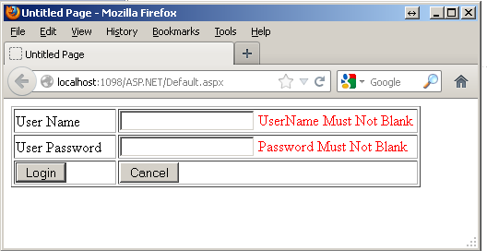
Def :
Design a Login Form with requiredfieldvalidator where username and password must not blank.

Slide 47
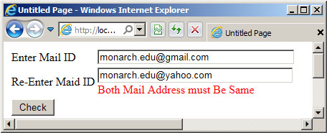
Def.
Design a form to enter user mail address and re-enter mail address again. If both are different then it will display a proper error message (CompareValidator).

Slide 48
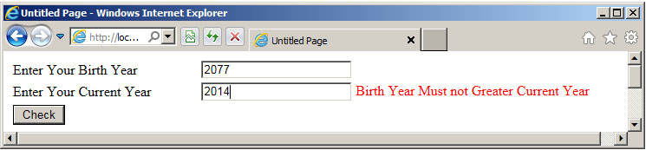
Def.
Design a form to enter your birth year and then current year...
If birth year is greater then Current year then provide a proper validation message as given.(CompareValidator)

Slide 49
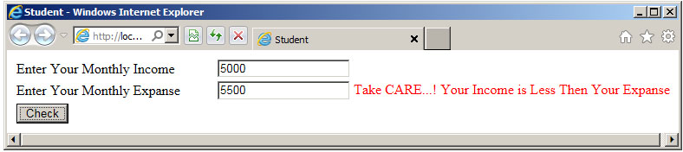
Def.
Design a form to enter your monthly income and monthly expense.
If expanse is greater then your income then it will give a Warning message. (CompareValidator)

Slide 50
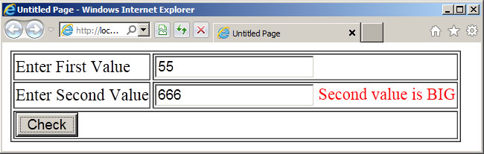
Def.
Design a form to enter To values.
Check that which number is GREATER? (CompareValidator)

Slide 51
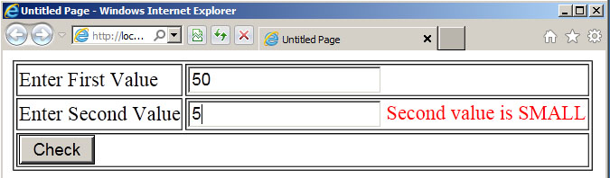
Def.
Design a form to enter To values.
Check that which number is SMALL?
(CompareValidator)

Slide 52
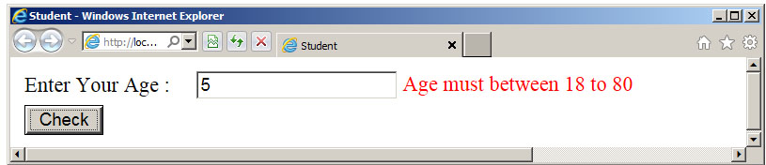
Def.
Design a form to enter your age, if age is between 18 to 80 then valid or Give Error message “Age must between 18 to 80”
Range Validator

Slide 53
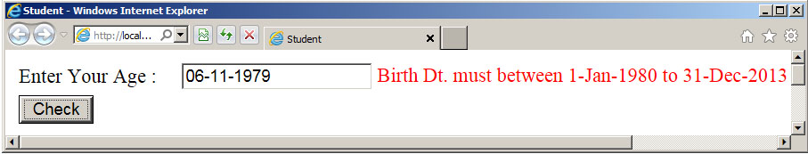
Def.
Design a form to enter your birth date within range of 1-Jan-1980 to 31-Dec-2013.
If date is out of this range then it will display a proper message.
Range Validator

Slide 54
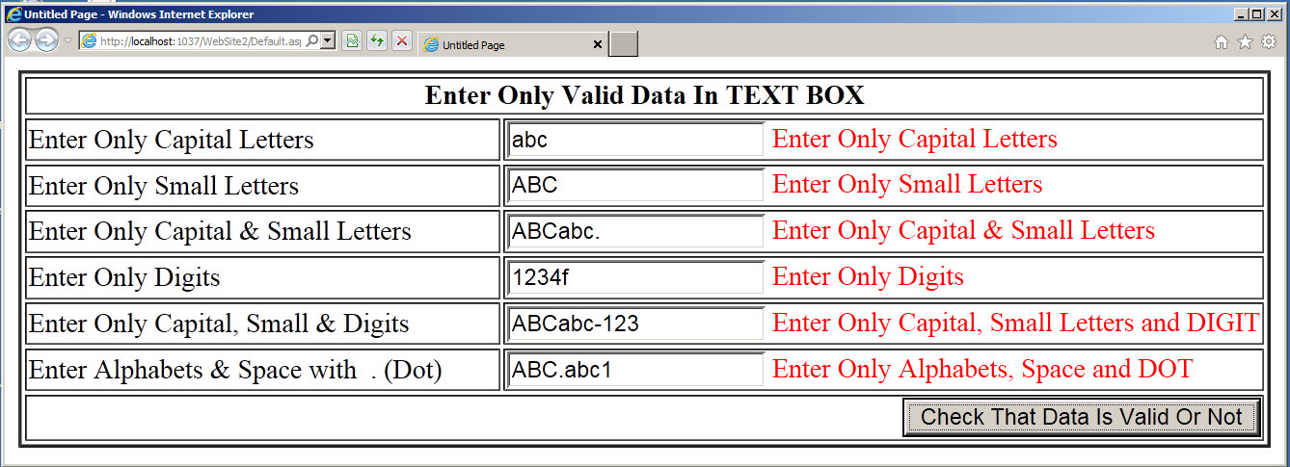
Def.
Design a form with
Text Box to Enter Only Capital Letters
Text Box to Enter Only Small Letters
Text Box to Enter Capital & Small Letters
Text Box to Enter Only Digits
Text Box to Enter Capital, Small Letters & Digits only
Text Box to Enter alphabets with . (DOT)

Slide 55
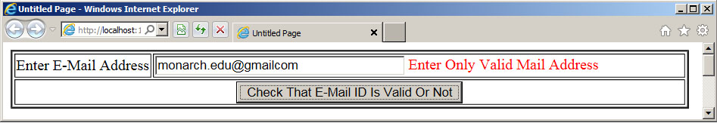
Def.
Validate an e-mail address using Regular Expression Validatore…

Slide 56
WebFor (Web Forms)
Web form are the heart of ASP.Net.
They provide user interface elements that give the web applications their look and feel.
They are similar to Windows Forms in that they provide properties, methods and events for the controls that are placed onto them.

Slide 57
WebFor (Web Forms)
Web Forms are made of two components :
  Visual File (.aspx file)
  Code behind File (.aspx.cs)
Visual File (.aspx file)
    Visual file provides the User Interface to the web page.
Code behind File (.aspx.cs)
    Code Behind File provides a place to code various events.

Slide 58
Features of ASP.NET Web Forms :
Server Controls :
  They are objects on ASP.NET web pages which run when the page is requested and that render markup to the browser.
  Many Web Server controls are quite similar to HTML elements, such as text boxes and buttons.
Master Pages :
  Master pages are used to create a consistent Page layout for the Web application.

Slide 59
Features of ASP.NET Web Forms :
  A single master page would define the look and feel and standard behaviour that would be applicable to all the pages in the Web Application.
  We can create individual content pages that contain which we want to display.
  When users request the content pages, a combination of content page and master page would produce output that combines the layout of master page with the content from content page.

Slide 60
Features of ASP.NET Web Forms :
Working with Data :
  ASP.NET provides multiple options for storing, retrieving and displaying date. Through controls place on ASP.NET web forms.
  We can use data bound controls to automate the presentation or input of data in web page UI elements such as text boxes and drop down lists.

Slide 61
Features of ASP.NET Web Forms :
Membership :
  ASP.NET Identity stores users’ credentials in a database created by the application. When users log in, the application validates their credentials by reading the database.
  Project’s Account folder contains the files that implement the various parts of membership: registration, loggin in, change password and authorizing access.

Slide 62
Features of ASP.NET Web Forms :
Membership :
  Additionally, ASP.NET web forms supports OAuth and OpenID.
  These helps us to log into our site using existing credentials, from such accounts as Facebook, Twitter, Windows Live, and Google.

Slide 63
Features of ASP.NET Web Forms :
Client Script and Client Frameworks :
  We can enhance the server based features of ASP.NET by including client script functionality in ASP.NET Web Form Pages.
  We can use client scripts to provide a richer, more responsive user interface to users. We can also use client script to make asynchronous calls to the web server while a page is running in the browser.

Slide 64
Features of ASP.NET Web Forms :
State Management :
  ASP.NET Web Forms includes several options that help us to preserve data on both a per-page basis and an application-wide basis.
Security :
  Through ASP.NET web forms, we can add extensibility points and configuration options which enable us to customize various security behaviours in ASP.NET web forms.

Slide 65
Features of ASP.NET Web Forms :
Performance :
  ASP.NET web forms enables us to modify performance related to page and server control processing, state management, data access, application configuration and loading, and efficient coding practices.

Slide 66
Features of ASP.NET Web Forms :
Debugging and Error Handling :
  ASP.NET Web forms also support Debugging and error handling features which enables us in making Web Form application more efficient.

Slide 67
Features of ASP.NET Web Forms :
Deployment and Hosting :
  Visual Studio, ASP.NET and IIS provide tools that help us to deploy and host Web Forms application easily and efficiently by following simple steps.

Slide 68
File Upload Control
ASP.NET Web Forms FileUpload control.
It is an input controller which is used to upload file to the server.
It creates a browse button on the form that pop up a window to select the file from the local machine.
To implementFileUpload we can drag it from the toolbox in visual studio.

